Slide 1




Evidence for the Chiral Anomaly in the Dirac Semimetal Na₃Bi
Jun Xiong, Satya Kushwaha, Tian Liang, Jason Krizan, Max Hirschberger, Wudi Wang, R. Cava, N.P. Ong
Princeton University
Supported by MURI, ARO, Moore Foundation, NSF

Slide 2
Content
1 Introduction to the Weyl and Dirac semimetals
2 Introduction to the chiral anomaly effect
3 Transport evidence for the chiral anomaly in Na₃Bi
4 Chiral anomaly in GdPtBi, a zero-gap semiconductor with strong spin orbit coupling

Slide 3
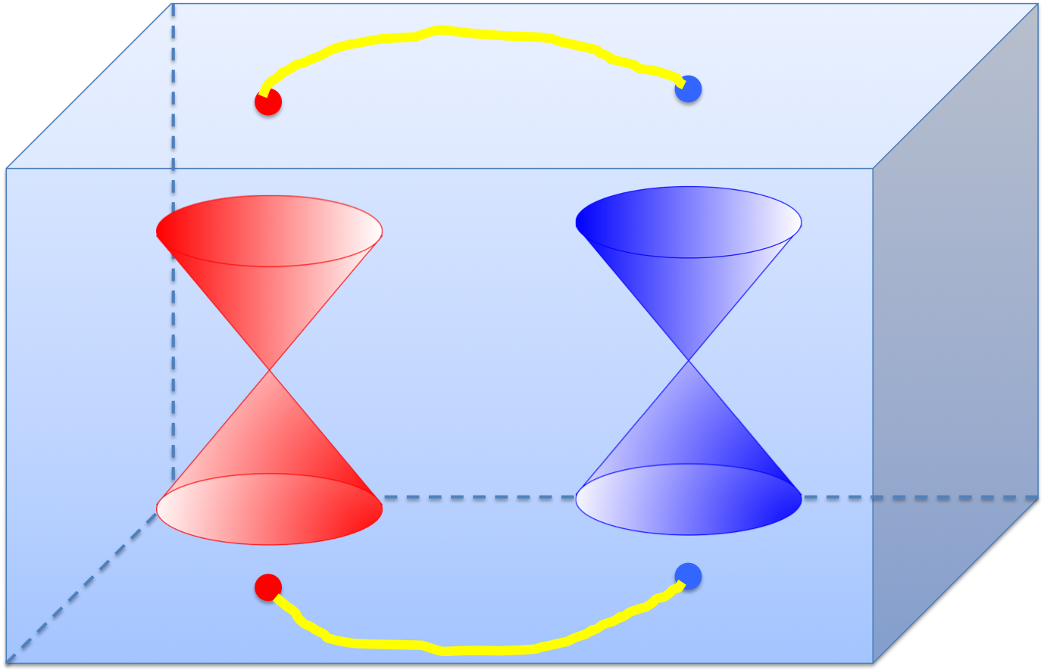

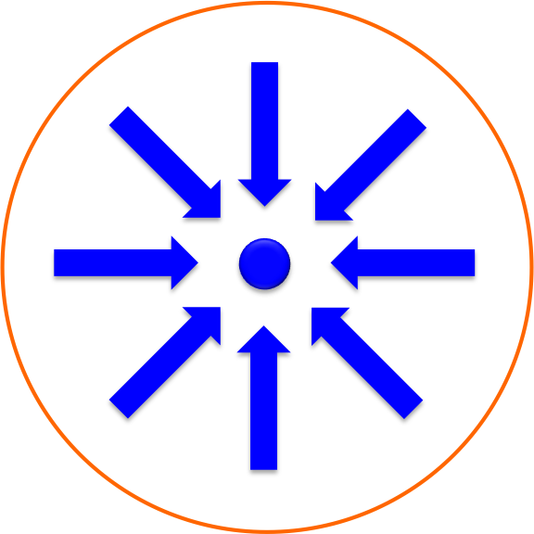
Weyl Node and Weyl Semimetal
Weyl branches have a linear
energy-momentum dispersion.
Similar to magnetic monopoles, Weyl nodes
serve as the sources and sinks of the Berry flux.
Berry vector potential
Berry flux
Fermi arcs connecting two Weyl nodes on the surface of TaAs
= 1
= -1
Hasan group, Science 2015
Notes:
Reduce the amount on Fermi arcs, briefly intro.
As we know, the Berry flux can be seen as magnetic field in the momentum space. So similar to magnetic monopoles, there are sinks and sources of Berry flux, which are called Weyl nodes. If we have a surface that encloses a Weyl node, we can calculate the total Berry flux through the surface, and it gives the chirality of the Weyl node inside.
When such Weyl nodes exist at different positions in the momentum space of a crystal, the bands around them have a linear dispersion. And the crystal becomes a Weyl semimetal. A characteristic of the Weyl semimetal is the predicted surface Fermi arcs that connect the Weyl nodes. Such predictions of WSM has been confirmed by ARPES experiments. For example, these are the results of ARPES experiments from Hasan. It shows two Weyl nodes in the WSM TaAs and the Fermi arcs that connect the two Weyl nodes.

Slide 4
Dirac Semimetal
Time-reversal (T) & inversion (I) symmetries pin opposite Weyl nodes at the same point in the Brillouin zone. With the point group symmetries, the gap-opening is prevented. When T or I are broken, the Weyl nodes will be separated.
In Na₃Bi, the Dirac node is protected
by C₃ symmetry
Below shows how the Dirac node is split by the magnetic field
Wang et. al., PRB 2012
Notes:
Then what is a Dirac Semimetal? When a crystal has both time-reversal (T) & inversion (I) symmetries, the Weyl nodes with opposite chiral charges stay at the same positions in the Brillouin zone. When the opposite Weyl nodes meet, they usually annihilate and open a gap. But with certain crystal symmetries, the gap-opening is prevented. And the linearly dispersed bands remain at these nodes. These nodes are also called Dirac nodes.
First principle calculation from Xi Dai’s group predicts that Cd3As2 and Na3Bi are such DSM. This pic shows the calculated band structure of Na3Bi, due to the C3 symmetry, there are two Dirac nodes along the kz direction. Here shows one Dirac node, and you can see the linear bands around it.
When T or I are broken, the overlapping Weyl nodes will be split. This pic is an example showing the splitting of two Weyl nodes in a magnetic field.

Slide 5
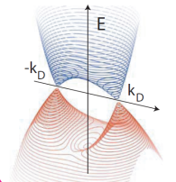
Band Structure of Na₃Bi
Only Na-3s and Bi-6p states lie near Fermi energy.
Crossings protected against gap formation
--- |S) and |P) states belong to different
irreducible representations of C₃.
Wang, et. al., PRB 2012
Protected by C₃ symmetry
2 Dirac nodes centered at K±
Na-3s
C
3
E
|S, ±½ )
60 meV
k_{D}
k_{z}
|P, ±3/2)
Bi-6p
Notes:
SOC -> Band inversion -> band crossings
Let’s take a look at DSM Na3Bi in details. The crystal has a stacked layers of Na and Bi atoms. It has C3 symmetry around the c axis. The relevant states are Na-3s and Bi-6p states, which are close to the Fermi energy. Due to strong SOC, the energy of these states shift and a band inversion happens. Thus there is a band crossing at kD on the kz axis. Due to the C3 symmetries, the crossings are protected from gap opening and we have two Dirac cones in the Brillouin zone.

Slide 6
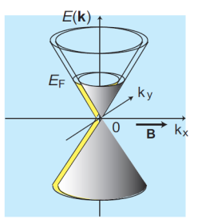
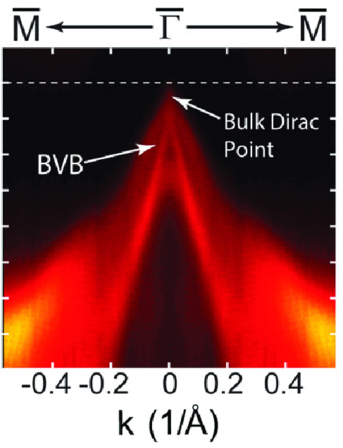
Hamiltonian and Chirality in Na₃Bi
The low-E Hamiltonian, close to node K₊, reduces to
Na
Bi
H resolves into two 2x2 Weyl Hamiltonians H₁, H₂
Wang, et. al., PRB 2012
The chirality is
We have a superposition of two opposite Weyl nodes at B = 0
Y. L. Chen Group, Science 2014
Notes:
The Hamiltonian of Na3Bi is a 4*4 matrix. Here we only retain the leading term and it’s linear in k. The off-diagonal terms are zero. As a result, the H can be resolved into two 2*2 Weyl H. H1 can be written by the product of the momentum, the velocity matrix v, and the the Pauli matrices. The determinant of the velocity matrix gives the chirality of the H. So the chirality of H1 is -1, and the chirality of H2 is 1.
As a result, at zero field, the Dirac node in Na3Bi can be regarded as the superposition of a pair of opposite Weyl nodes.
The pic is the ARPES data of the Dirac node in Na3Bi.

Slide 7



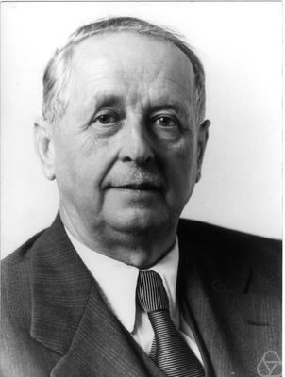
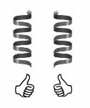
Weyl Fermion and Chiral Anomaly
Dirac Equation:
m = 0
Weyl Equations:
Describing left-handed and right-handed Weyl fermions with a conserved chirality.
For spin ½ fermion, the chirality operator is:
Notes:
Before we jump into the experimental data, let me briefly introduce the chiral anomaly effect. Fermions are described by the Dirac equation. In the Dirac equation, the wavefunction psi has 4 components, and gamma is a 4*4 matrix. When the mass is zero, the Dirac equation can be reduced to two separate parts (2x2). These equations are Weyl equations, each of which has 2 components. And they describe left-handed and right-handed Weyl fermions respectively. Sigma are the Pauli matrices. These fermions have a conserved chirality in free space. So a left-handed Weyl fermion will not change to a right handed one.
The handedness of the particle is described by the chirality operator gamma5. It is the product of the spin and momentum operator. Thus if the spin direction is the same as the momentum direction, the chirality of the particle is 1, and it’s a right handed particle. Otherwise, the chirality is -1, and it’s a left handed particle.

Slide 8
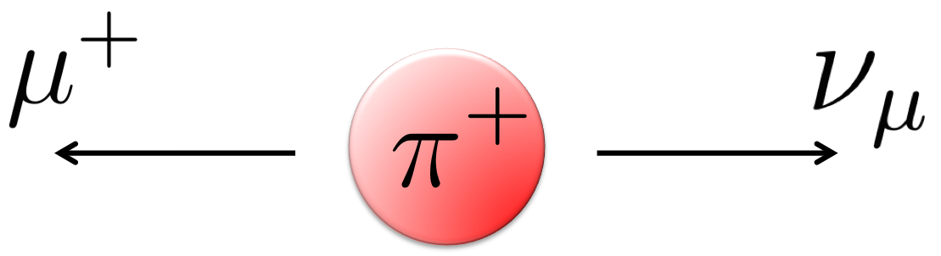
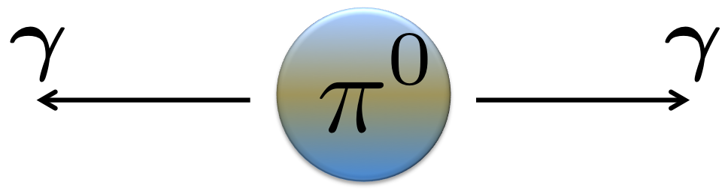
The Adler Bell Jackiw (or chiral) anomaly
The chiral symmetry is violated when Weyl fermions are coupled to the electro-magnetic field.
Charged pion decay
Neutral pion decay
Long lived charged poins decay only into leptons
Neutral pions break chiral symmetry by decaying into 2 photons (300 million times faster!)
(Adler, Bell, Jackiw, 1969)
The axial current is not conserved!
Notes:
Although the chirality is conserved in zero fields, a surprise is that the presence of parallel electric and magnetic fields will break the chirality conservation. This was found in the pion decay prcoess. A charged pion decays into a muon and a neutrino. This process is slow. People found that a neutral pion decays into two photons and the process is 3*10^8 faster. Adler Bell and Jackiw found that the chiral symm is not conserved in this process. They found that the chiral current follows this equation here. So on the right term is not zero. It means that the chiral charge can be created when E and B are parallel.

Slide 9
Chiral Anomaly in a Crystal
Nielsen and Ninomiya (Phys. Lett. 1983) proposed the chiral anomaly should appear in crystals.
Burkov, Science 2015
Last Landau Level is chiral in Weyl states.
+
A charge pumping effect between different branches of chiral Weyl nodes when E and B are parallel.
Notes:
Emphasize Landau levels here
In 1980s, Nielsen and Ninomiya suggested that the chiral anomaly effect can also appear in crystals. If you have both a left-handed Weyl branch and a right-handed Weyl branch in the crystal, parallel E and B can pump electrons from one branch to the other.
This pumping effect can be understood more easily with the help of Landau levels. As shown in this carton made by Burkov, the Weyl fermions will be quantized into Landau levels in the presence of parallel E and B. At the lowest Landau level, the energy-momentum dispersion is linear, and we can obtain the degeneracy of the Landau level. As we learned in solid state physics class, the electric field will make the electrons move in momentum space. Thus the e in one Weyl branch will decrease and e in opposite Weyl branch will increase. Thus there is pumping effect between opposite Weyl branches and the pumping rate is . Therefore, the total pumping rate is proportional to the E dot B term.

Slide 10
Chiral Anomaly in a Crystal
In weak B, with B||E, using the Boltzmann kinetic equation:
and the relaxation time approximation, Son and Spivak (PRB, 2013) found a negative longitudinal magnetoresistance (LMR) as below:
τ_{a} is relaxation time
for pumped current
A long τ_{a} is essential for the observation of the negative LMR. τ_{a} increases with the decrease of E_{F}.
Notes:
Emphasize weak field here, list ingredients
The above slide is a simple pic for chiral anomaly effect at the lowest LL. When B is weak, we can use Boltzmann equation to describe the charge pumping effect between diff Weyl branches. Son and Spivak used a relaxation time approximation to solve this problem, and found that the chiral anomaly will cause a negative longitudinal magnetoresistance (LMR). They found that when B || E, the longitudinal conductivity in B has a quadratic enhancement as described by the formula here. τ_{a} is relaxation time for pumped current.
From the formula, you can see that to get a large effect, we need a long τ_{a}. Also if EF is small, the negative MR will also be large.

Slide 11

Na₃Bi Crystals with a High E_{F}
Kushwaha
Container used to protect and measure Na₃Bi
rapidly oxidized in
ambient air (30 s)
Notes:
To search for the chiral anomaly, we grow some Na3Bi crystals. These are the pic of the Na3Bi crystals that we grow. The crystal is like a plate and has a distorted hexagonal shape. A difficult thing is that Na3Bi can be oxidized in air within 30s. So we have to seal the sample very well for the measurement. We have to mount the sample in a glove box, seal the sample in this container and quickly put the sample in the cryostat.
In our first sample growth effort, the R-T dependence of the sample has a metallic behavior. Also, the Hall signal indicates a large carrier density, on the order of 10^19 cm^-3.

Slide 12
Linear Magnetoresistance in Na₃Bi Crystals with a High E_{F}
Linear MR in 8 samples
Notes:
This pic shows the MR of the Na3Bi crystals with a high EF. The MR of several diff samples are all linear. When we tilt the magnetic field, the MR remains linear and positive. We have also observed strong quantum oscillations in both the MR and torque data. And the freq of the oscillations shows that EF is very high, about 400meV above Dirac point. Here a fit to the T dependence of the amplitudes gives the Fermi velocity, which is consistent with the ARPES result.

Slide 13
Negative Longitudinal Magnetoresistance in a Na₃Bi Crystal with a Low E_{F}
E || B
The non-metallic R v.s. T profile indicates a low E_{F} near the Dirac point.

Slide 14
Na₃Bi crystals with a Low Carrier Density
Quantum Oscillations
small compared with
E_{F} ~ 30 meV, n ~ 10¹⁷ cm⁻³
Fermi sea volume determined by S_{F} in good agreement with density n inferred from R_{H}
Carrier mobility
μ = 3,000 cm²/Vs at 4 K
Hall Signals

Slide 15
A test for chiral anomaly -- B is locked to E
Negative MR appears only when B is locked to E.
Test: if E is rotated by 90º (right panel), neg. MR shifts to the new direction of E.
For weak B, this locking is novel and unexpected in semi-classical transport.
Notes:
The scattering rate also grows with the field, as the DOS grows, so it saturates at high B

Slide 16
A narrow plume of chiral current, B in-plane
Enhanced cond. in a narrowly collimated beam for B in the x-y (horizontal) plane

Slide 17
Width of chiral conductivity “plume”, B normal to plane
Enhanced cond. in a narrowly collimated beam for B rotated in the x-z (vertical) plane

Slide 18
Signature of chiral anomaly: B locks direction of axial current
Locking of observed axial current to B (even in weak B) seems to be a signature characteristic of the chiral anomaly.
Axial plume direction fixed by B (and E)

Slide 19
Relaxation time τ_{a} of the pumped axial current
In semiclassical regime, Weyl node conductivity grows as B² (Son, Spivak, PRB ‘13).
The fitting implyes: the axial current relaxation time τ_{a} ~ 40 – 80 τ₀ (τ₀ is the Drude life time).
Possible reasons for the suppression of the axial current relaxation:
Charged impurities are well screened (Thomas-Fermi factor ) for large valley scattering (Δk >> k_{F} ).
Violation of chiral symmetry is weak at low B, so chiral coupling to impurities
is weak.
Question: Does the large ratio (τ_{a} / τ₀ ) reflect near-conservation of chiral charge?

Slide 20
High-Field Kink
A turn-up trend at high field may indicate the sensitivity of the axial current to the alignment of E and B.

Slide 21
Weyl Nodes in the half-Heusler GdPtBi
Hirschberger, et. al., arXiv: 1602.07219
Notes:
zinc blende structure structure, put zhijun wang’s bands here, Bi 6p states. Zero gap in zero field. A carton what think is happening. The zeeman energy will shift red up, blue down, depends on the direction of the field, axis dependent. The crossings are protected. Imitate Na3Bi,put MR(at diff T) together. C The perpendicular field drops R by five times or higher
Here I also hope to introduce another material that shows evidence for chiral anomaly. The material is a half-Heusler compound, GdPtBi. It has zinc blende structure. Here is the Brillouin zone. According to first principle calculation, near the EF, the crystal has a touching point at the Gamma point. And each band has degeneracy of two here, so there’s a total degeneracy of 4 at Gamma point. In a magnetic field, the different Zeeman energy of the bands lead to opposite Weyl nodes. And it also provides a platform for the study of Weyl physics.
The non-metallic RT profile and the sharp decrease in Hall density is consistent with the zero gap feature.

Slide 22
Negative Magnetoresistance in the half-Heusler GdPtBi
GdPtBi
Na₃Bi
Notes:
When B || I,negative. then B has two jobs, creating the Dirac nodes and then chiral anomaly. Not oscillations,SF ~30T. The plume is non-cos like.
Order at 8K, goes anti-ferromagnet,
When we apply B parallel to the current, we can also observe a large negative MR signal. It’s very similar to the negative MR of Na3Bi. The negative MR is the largest at low T, and gradually becomes smaller at higher T. It’s there until around 100K.
When B is deviated from I, the negative MR gradually becomes smaller and in the end it becomes positive. This trend is also similar to that of Na3Bi.

Slide 23
Chiral Anomaly in the half-Heusler GdPtBi
GdPtBi
Na₃Bi
Notes:
The angular dependence of the conductivity enhancement in GdPtBi is similar to that of Na3Bi as well. It’s the largest around 0 degree. And when the B field increases, the enhancement becomes sharper. As we discussed earlier, this is a characteristic feature of chiral anomaly. Thus it provides support for the chiral anomaly effect in GdPtBi.

Slide 24
Conclusion
Negative longitudinal magnetoresistance in non-metallic Na₃Bi.
Qualitatively consistent with the chiral anomaly effect by rotating both E and B.
The axial current is locked to B and E.
τ_{a} ~ 40 – 80 τ₀
GdPtBi shows evidence for the chiral anomaly effect

Slide 25
Thank You!

